Slide 1
ABSTRACT
The MLA Helper website provides basic information of kerala. Italso gives the information of MLA’s. The users can view districts,constituencies and complaint status. They can view information of MLA. Administrator has the full control of the website. The users can view address, mobile number and email id of MLA’s. The MLA details are available in the siteThe website provides information about events and committee meeting details. The website provides a great opportunity for users to interact with the MLA’s . This help to solve their problems easily. The online registration is available. Users have the option to posttheir forums and MLA replies, if their problem is solved. The MLA Helper website is really helpful for the MLA’s,and users

Slide 2
PROPOSED SYSTEM
The proposed system used by the Administrator, MLA, and User. Since we have created a system in which all the people who are associated with a district are taken into account and could use the benefits of the system.The main advantage here is that as it is automates all the details of the working and management of MLA. The most striking feature is that there are different levels of authentication within this system. For example, the administrators in the MLA have an ability to add the details and also the administrators can view.Proposed system improves the system’s performance because the current system is based on manual processing while the proposed system is based oncomputer processing.

Slide 3
MODULE
1.Administrator module
Administrator has the full control of the website. The users can view address, mobile number and email id of MLA’s. The MLA details are available in the site. Administrator requires thefollowing functionalities such as mla,constituency,fund allocation to MLA. Admin can view scheme to MLA, Local Area Development, Estimate Cost Approval,Fund To MLA,Fund usage , Complaint,Request.Admin can genereate Yearly/Monthly Report . Administrator can view the users and can remove the user from system.

Slide 4
2.MLA module
MLA requires the following functionalities such as user , fund approval,eventmanagement,scheme and estimate Cost Approval.View Fund To MLA,Fund usage, Appointment,Complaint, Request,User Register, Complaint Register, Feedback,Answer To Question,Get monthly/yearly complaint report..MLA gets mobile alert message when he has any programme.

Slide 5
3. User module
The users can view the local area development projects and schemes of MLA’s.Send Feedback, ComplaintRegistration, Request To MLA, Ask Question ,Appointment Request,MLA fund usage. User can View complaint Status, Request Status, Answer, Event .Users have the option to post their forums and MLA replies. Users get a message through mobile, if their problem is solved.

Slide 6
1. Net beans NetBeans IDE is a free, open source, integrated development environment (IDE) that enables you to develop desktop, mobile and web applications. The IDE supports application development in various languages, including Java, HTML5, PHP and C++. The IDE provides integrated support for the complete development cycle, from project creation through debugging, profiling and deployment.
The IDE runs on Windows, Linux, Mac OS X, and other UNIX-based systems. The IDE provides comprehensive support for JDK 7 technologies and the most recent Java enhancements. It is the first IDE that provides support for JDK 7, Java EE 7, and JavaFX 2. The IDE fully supports Java EE using the latest standards for Java, XML, Web services, and SQL and fully supports the GlassFish Server, the reference implementation of Java EE.

Slide 7
2. Git hub The IDE provides comprehensive support for JDK 7 technologies and the most recent Java enhancements. It is the first IDE that provides support for JDK 7, Java EE 7, and JavaFX 2.
The IDE fully supports Java EE using the latest standards for Java, XML, Web services, and SQL and fully supports the GlassFish Server, the reference implementation of Java EE.

Slide 8
EXISTING SYSTEM
In the existing system, it is completely managed by pen and paper work. This system is time consuming and it has lot of drawbacks. It must require a lots of time for enteringinformation into a record and also for searching mechanism. It is completely depends on paper and pen work.Because of this reason editing updating and correcting any data in the record is very difficult.

Slide 9
TABLES
Login table
Purpose: Used to store the login details
Primary key: Username
Column name | Data type | constraints
Username | Varchar(20) | Primary key
Password | Varchar(50) | Not null

Slide 10
userreg table
Purpose: Used to store the user registration details
Primary key: Uid
Colume name | Data type | Constraints | Description
Uid | Int(11) | Primary key | user id
Name | Varchar(50) | Not null | Name of user
Address | Varchar(50) | Not null | User address
Email | Varchar(50) | Not null | Email id
Age | Varchar(50) | Not null | User age
Pass | Varchar(50) | Not null | password
User | Varchar(50) | Not null | User name

Slide 11
Mlareg table
Purpose: Used to store the mla registration details
Primary key: mid
Colume name | Data type | constraints | Description
Mid | Int(11) | Primary key | Mla id
Name | Varchar(50) | Not null | Name of mla
Address | Varchar(50) | Not null | Mla address
Email | Varchar(50) | Not null | Email id
Age | Varchar(50) | Not null | Mla age
Cons | Varchar(50) | Not null | constituency
Pass | Varchar(50) | Not null | password
User | Varchar(50) | Not null | User name

Slide 12
Fund table
Purpose: Used to store the fund details
Primary key: fid
Colume name | Data type | constraints | Description
Fid | Int(11) | Primary key | Fund id
Mla | Varchar(20) | notnull | Name of mla
Fund | Varchar(50) | notnull | Fund amount
Place | Varchar(50) | notnull | Place name
Cons | Varchar(20) | notnull | constituency
Idate | Date | notnull | Issue date
Purpose | Varchar(50) | notnull | Purpose of fund

Slide 13
Message table
Purpose: Used to store the message details
Primary key: msid
Colume name | Data type | constraints | Description
Msid | Int(11) | Primary key | Message id
Little | Varchar(20) | notnull | Little of message
Message | Varchar(50) | notnull | Content of message
To | Varchar(20) | notnull | Sender
Frm | Varchar(20) | notnull | Receiver
Reply | Varchar(50) | notnull | Message reply

Slide 14
Appointment table
Purpose: Used to store the Appointment details
Primary key: aid
Colume name | Data type | constraints | Description
Aid | Int(11) | Primary key | Appointment id
Date | Varchar(50) | notnull | Appointment date
Time | Varchar(50) | notnull | Appointment time
To | Varchar(50) | notnull | Sender
Frm | Varchar(50) | notnull | Receiver

Slide 15
Eventtype table
Purpose: Used to store the event type details
Primary key: eid
Colume name | Data type | constraints | description
Eid | Int(11) | Primary key | Event id
Event | varchar | notnull | Event name
Venu | varchar | notnull | Event venu
Place | varchar | notnull | Event place
Time | varchar | notnull | Event time

Slide 16
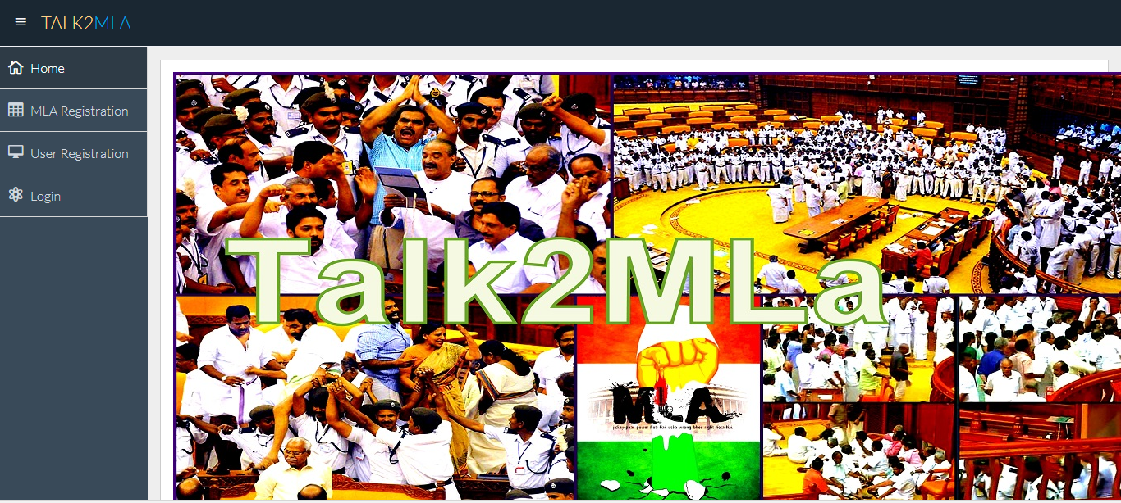
FORMS

Slide 17
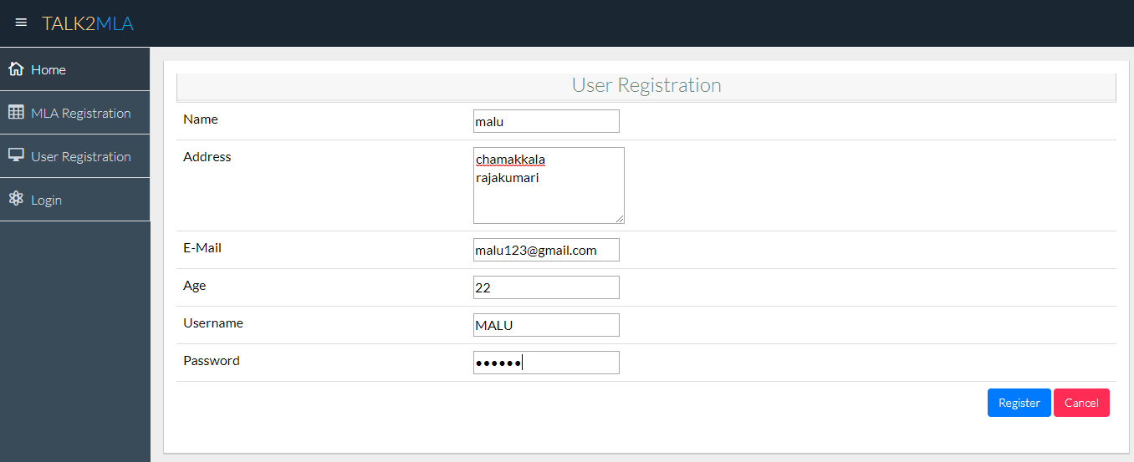
User registration

Slide 18
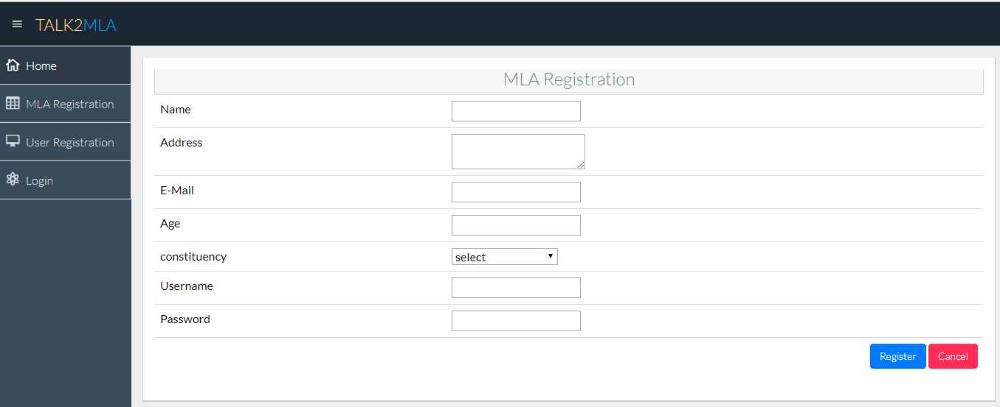
Mla registration

Slide 19
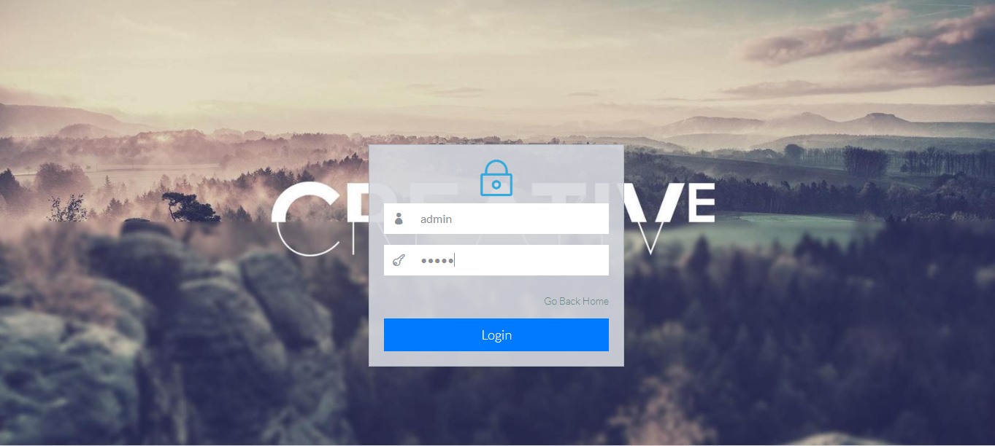
Admin login

Slide 20

Admin home page

Slide 21
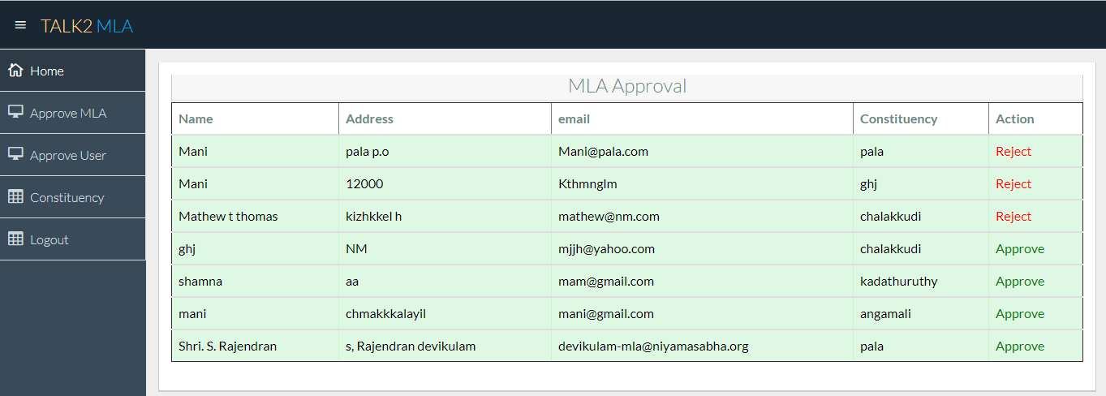
Mla Approval

Slide 22
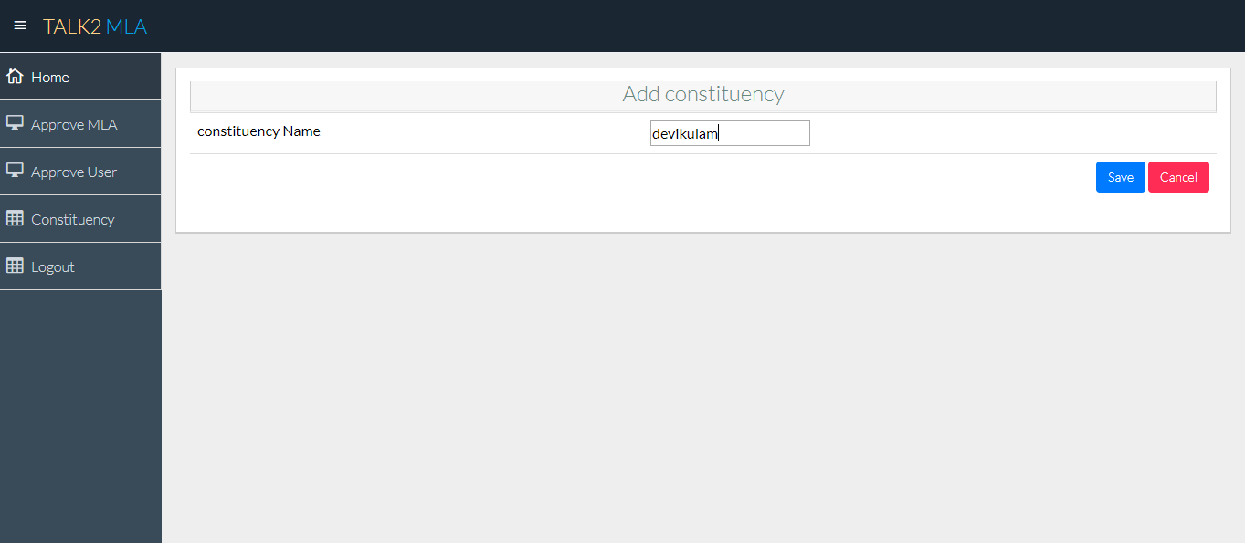
constituency

Slide 23
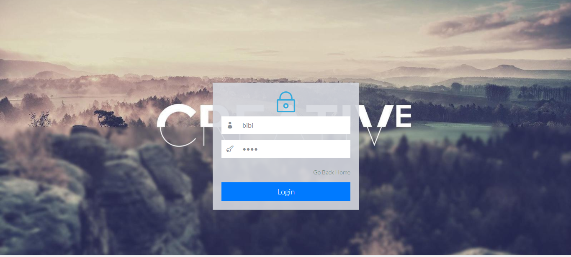
User login

Slide 24
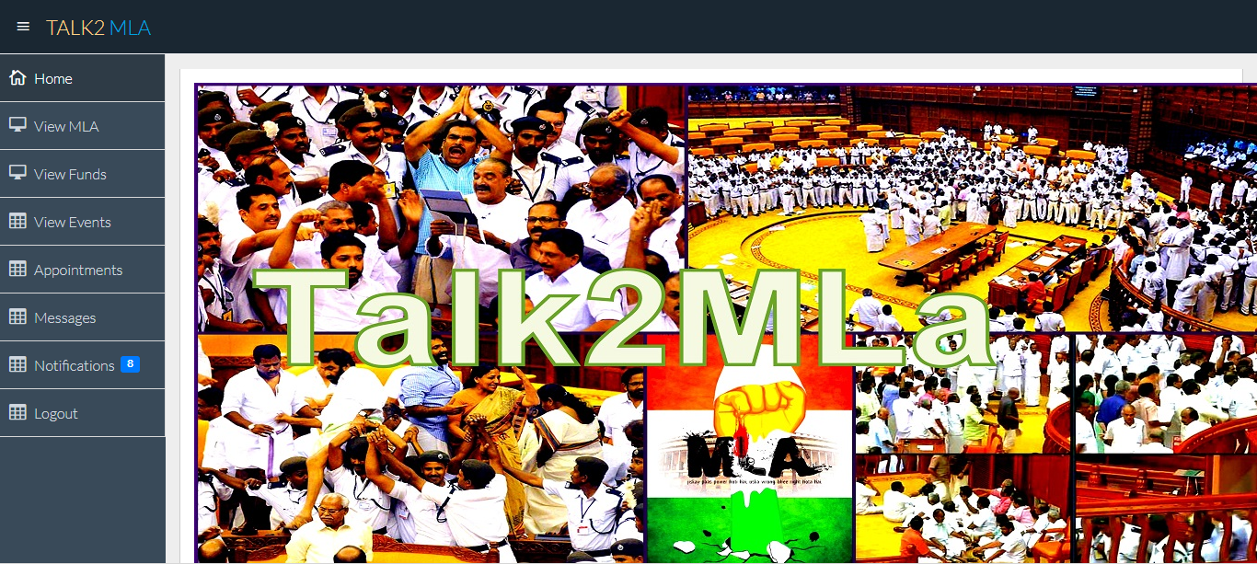
User home page

Slide 25
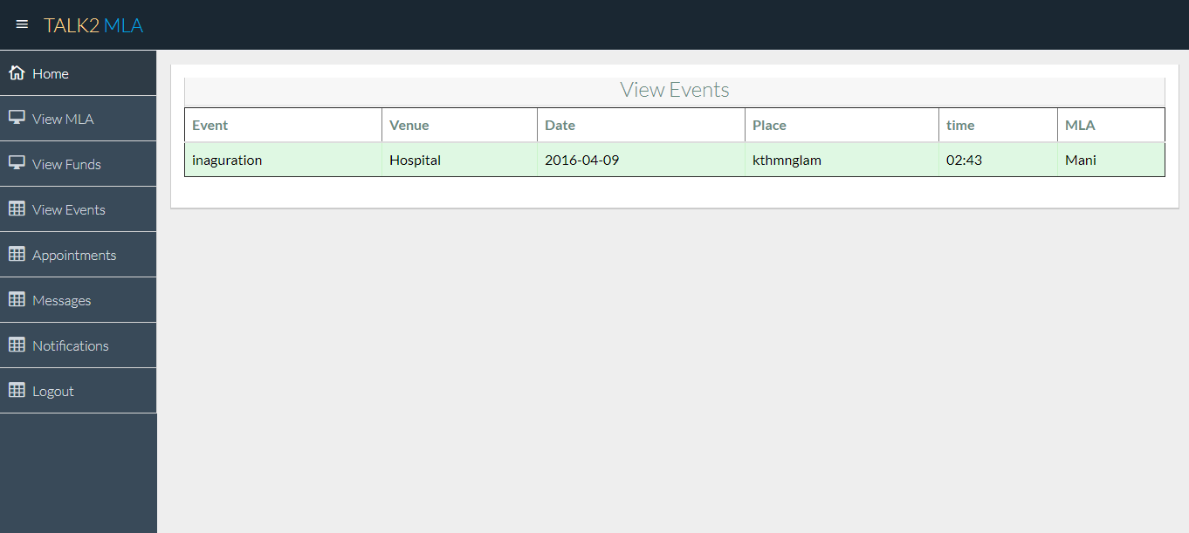
View events

Slide 26
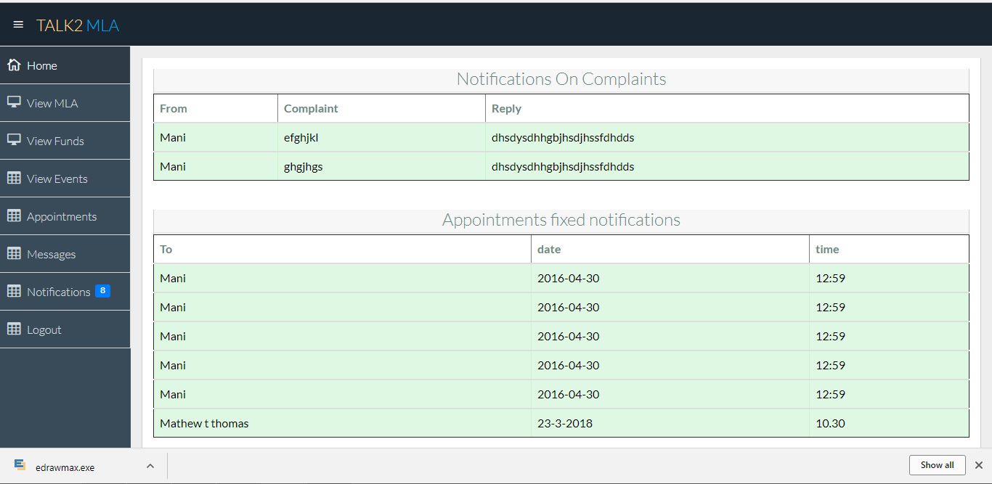
Notification

Slide 27
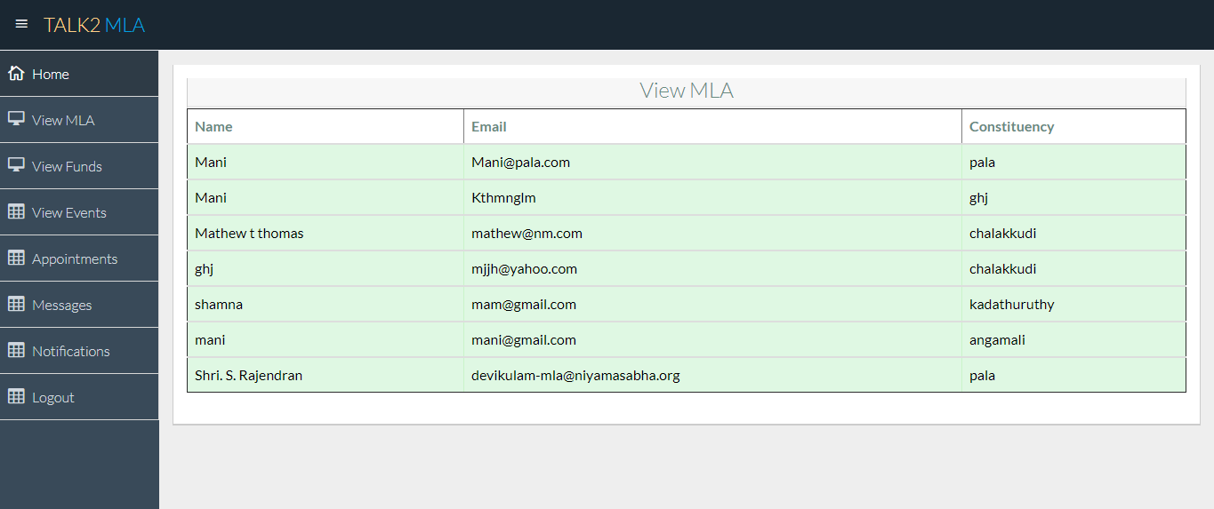

Slide 28


Slide 29
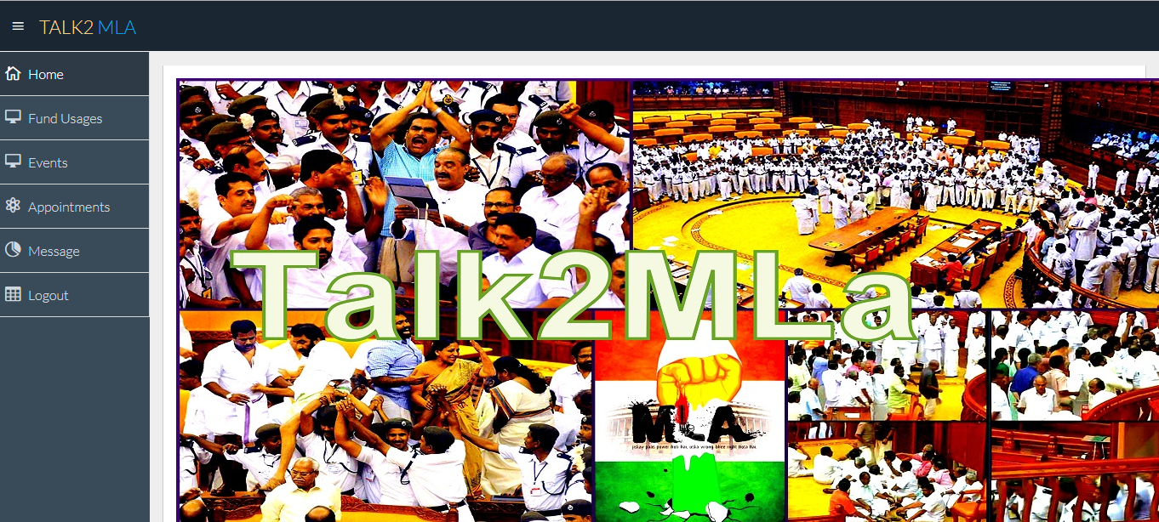

Slide 30
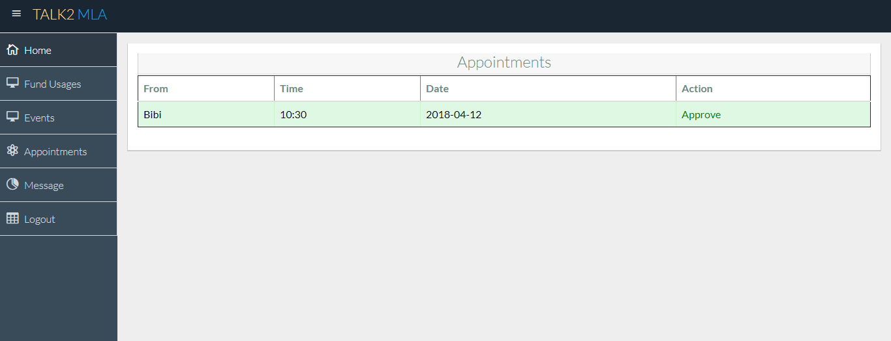

Slide 31
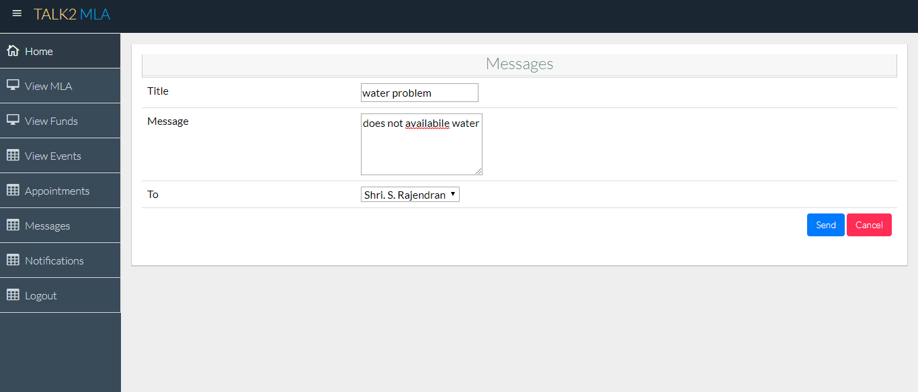

Slide 32
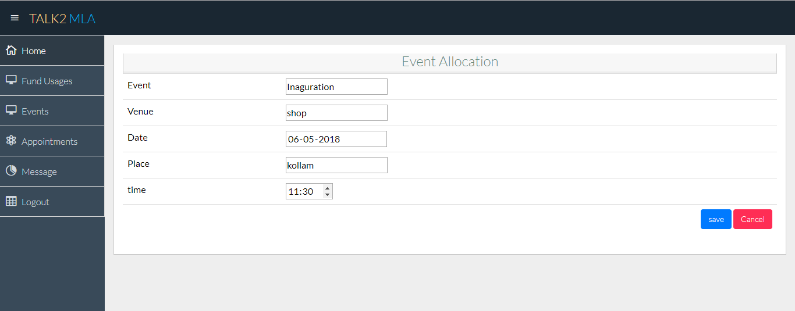

Slide 33
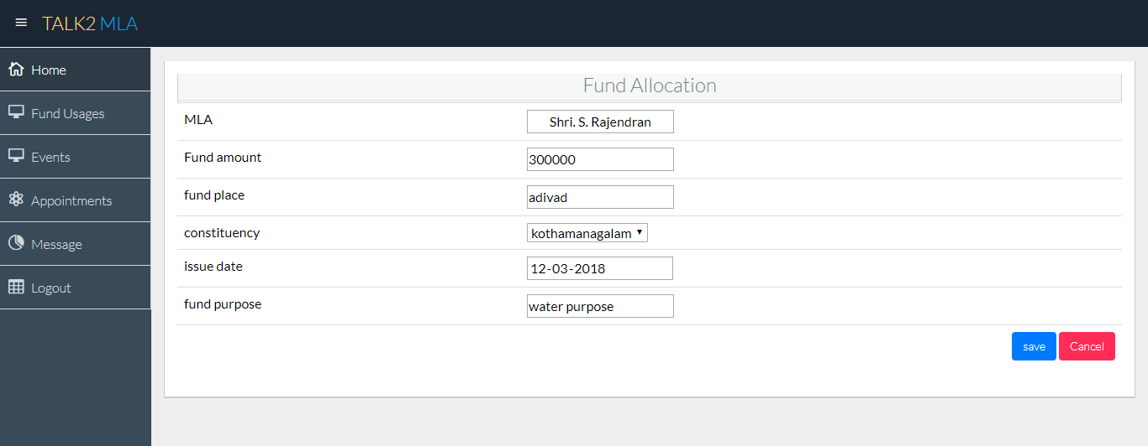

Slide 34
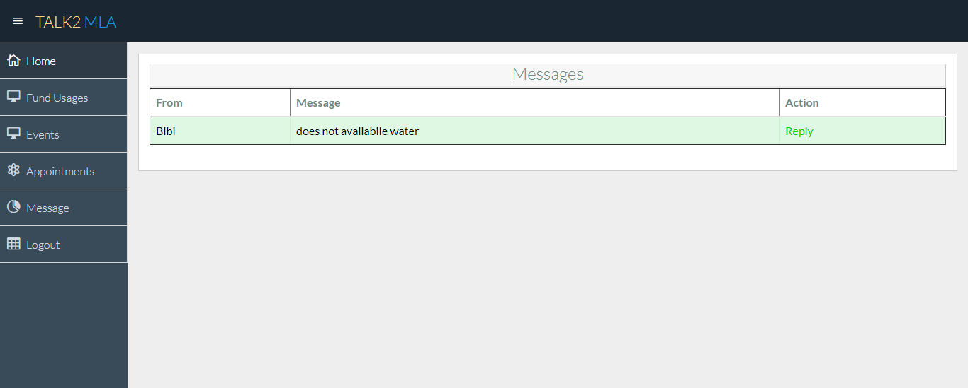

Slide 35
